Slide 1
Defensive Security Project 3
By: Mohammed Odeh
Janvalsi Petit
Richard Scott
Eileen Kealy

Slide 2
Table of Contents
This document contains the following resources:
Monitoring Environment
Attack Analysis
Project Summary & Future Mitigations

Slide 3

Monitoring Environment
‹#›

Slide 4
Scenario
In the highly competitive landscape of Technology industry , companies are constantly vying for market share. Our company Virtual Space Industries (VSI) has become a target for cyber threats. To safeguard its digital assets, the company has implemented Splunk, a leading security information and event management (SIEM) solution.
By using Splunk we can detect and respond to cyber threats swiftly, gain insights into the strategies employed by JobeCorp with timely identification of malicious activities which is crucial to prevent potential data breaches or service disruptions.
Splunk has been integrated into our cybersecurity framework, actively ingesting and analyzing log data from various sources, including network devices, servers, and applications. Real-time monitoring and correlation capabilities allow our security team to identify malicious behavior and potential threats .
Upon detection of potential threats, Splunk helps VSI trigger automated alerts, prompting our SOC Analyst team to conduct a thorough investigation. The team follows a predefined incident response plan, involving isolation of affected systems, analysis of compromised data, and collaboration with relevant authorities if needed.

Slide 5
Website Monitoring App
‹#›

Slide 6
Website Monitoring
Casually checks and assesses the effectiveness of URLs or web apps to guarantee the best possible user experience and performance
Puts procedures in place to ensure the web application or URL runs continuously and resolves possible problems quickly to reduce downtime
Carefully logs the amount of time it takes for the URL to react, supplying data on common and uncommon performances
Enables Pro Active management by spotting possible issues or disturbances in the web app
Creates a reliable system for response authentication guaranteeing that the website shows accurate and legitimate results
strengthens trust and safety by authenticating the accuracy of the content being shown avoiding problems like illegal modifications or false info.

Slide 7
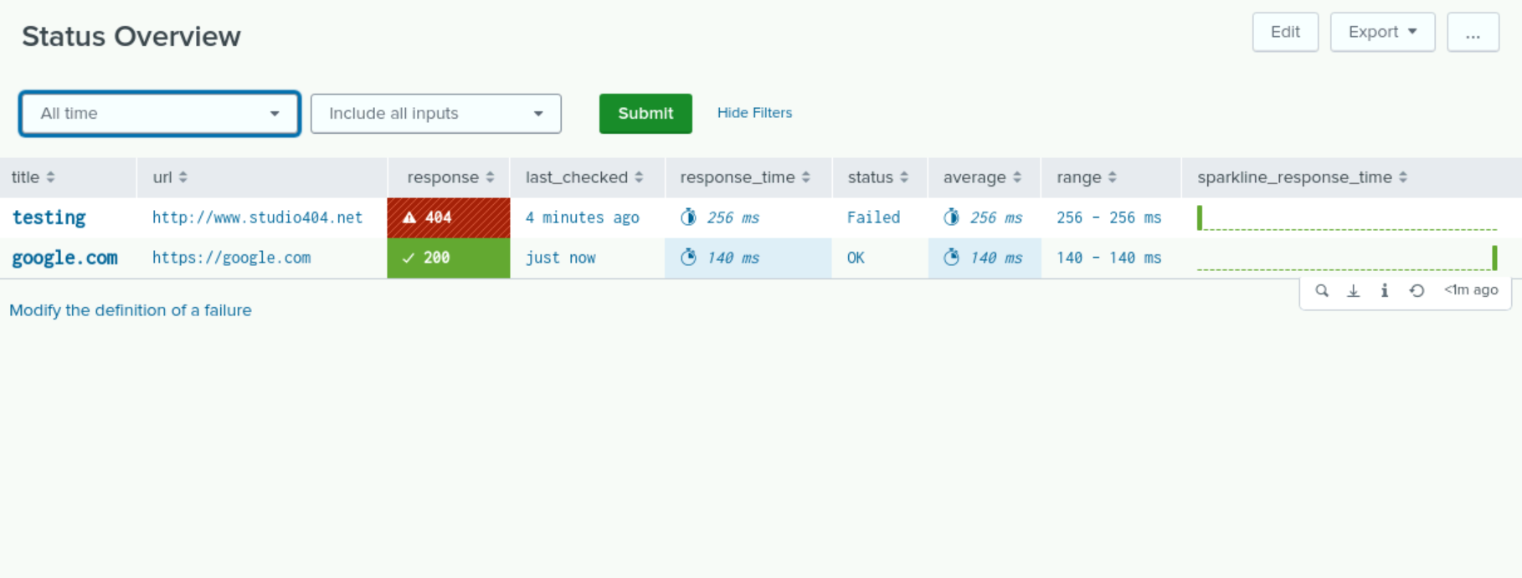
Website Monitoring

Slide 8
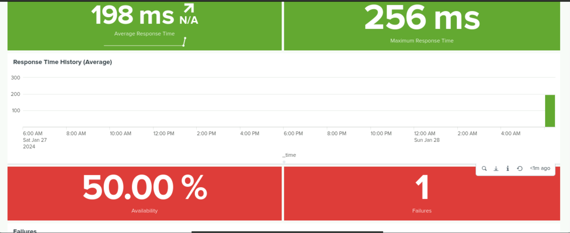
Website Monitoring

Slide 9
Logs Analyzed
Windows Logs
Apache Logs
1
2
The windows logs contain details on the users activities on the server, including severity levels, any modifications the user performed, and the login status, which shows success or failure
The logs hold details on the IP addresses in contact with the servers and with the website. They show the website react to different IPs and captures the servers request which reveals the browser

Slide 10
Windows Logs
‹#›

Slide 11
Reports—Windows
Report Name | Report Description
Windows Signatures | Displays the activity of logged in users as well as their ID numbers for each hour.
Severity Level | Shows the total count of examination logs to understand the level of impact.
Status Failure | Displays how many users were locked out and successfully logged in each hour.

Slide 12
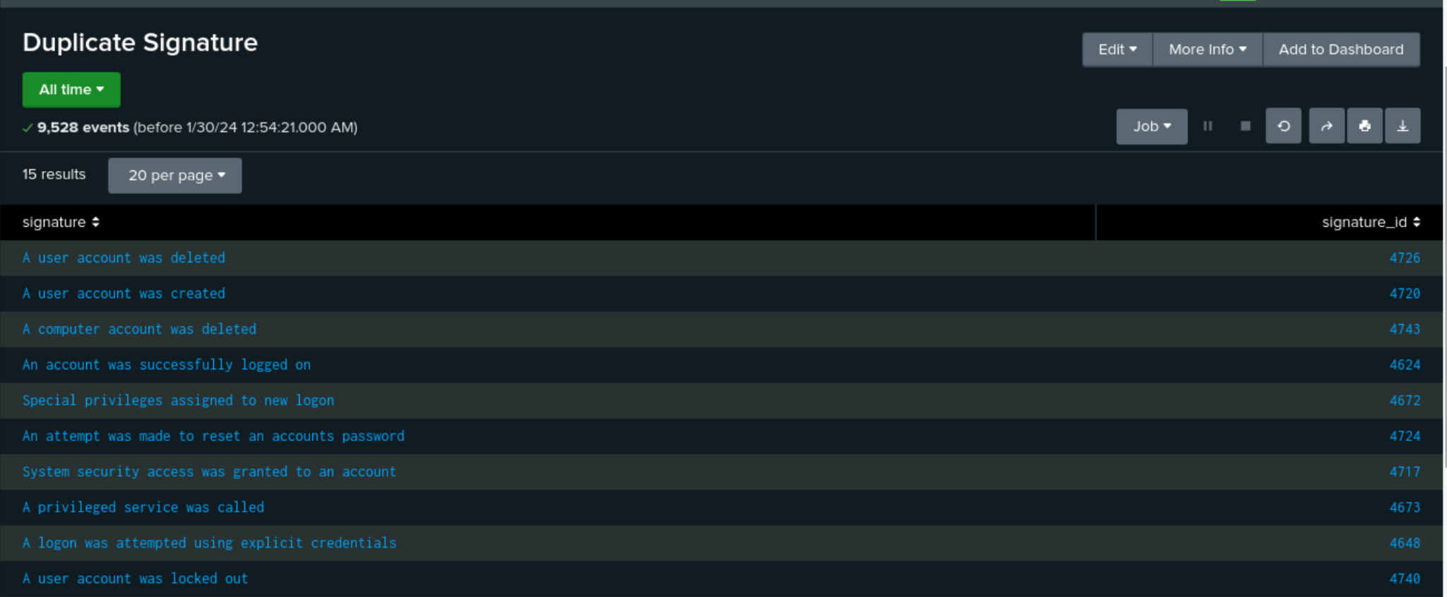
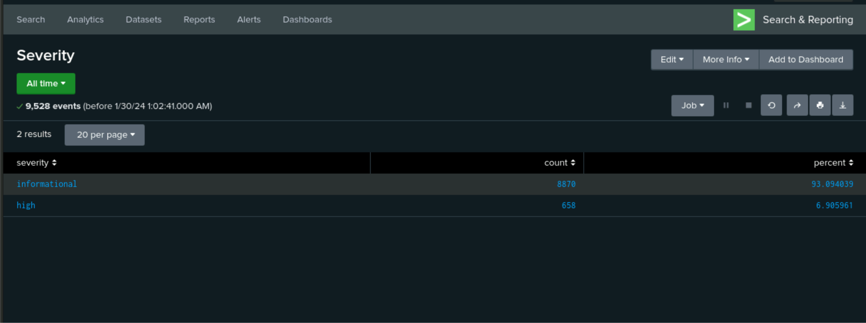
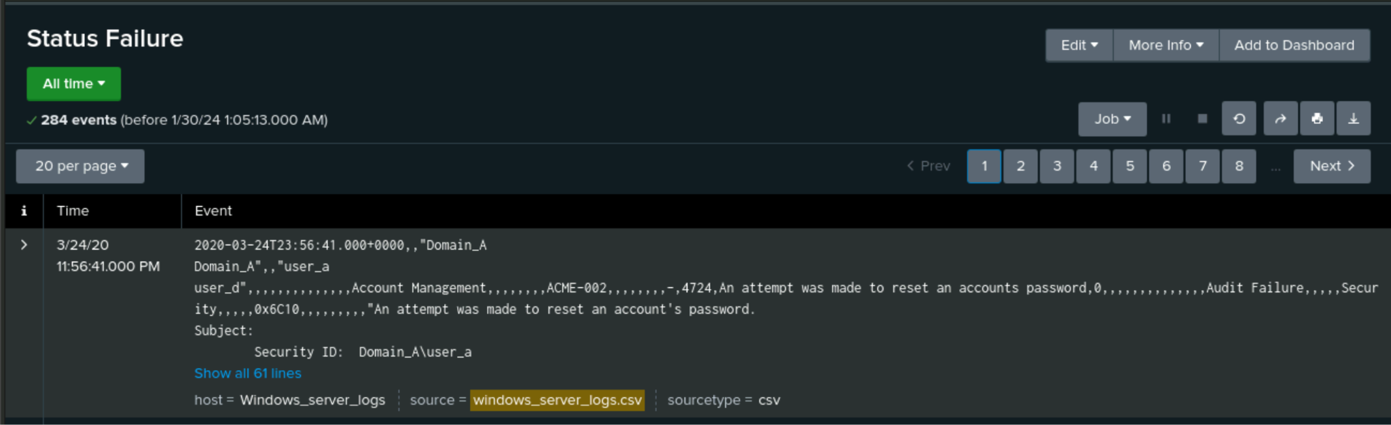
Images of Reports—Windows
Report Image
Report Image
Report Image
Report Image

Slide 13
Alerts—Windows
Alert Name | Alert Description | Alert Baseline | Alert Threshold
Failed Logins | Alert will notify SOC@VSI-company.com team when attempts are above baseline. | 7 | 13
JUSTIFICATION: We looked at the data and found that 7 was above the average failed logins. It was lower than the most extreme amount of logins.

Slide 14
Alerts—Windows
Alert Name | Alert Description | Alert Baseline | Alert Threshold
Sucessfully_logged_on | Number of alerts resulting in 19 successful logins. | 12-13 | 19
JUSTIFICATION: Due to the large quantity of successful logins we set our thresholds at 19 to avoid alert fatigue.

Slide 15
Alerts—Windows
Alert Name | Alert Description | Alert Baseline | Alert Threshold
Deleted _Account | Alert when account is deleted. | 19-20 | 28
JUSTIFICATION: Due to large quantities of data we set threshold higher to avoid alert fatigue.

Slide 16
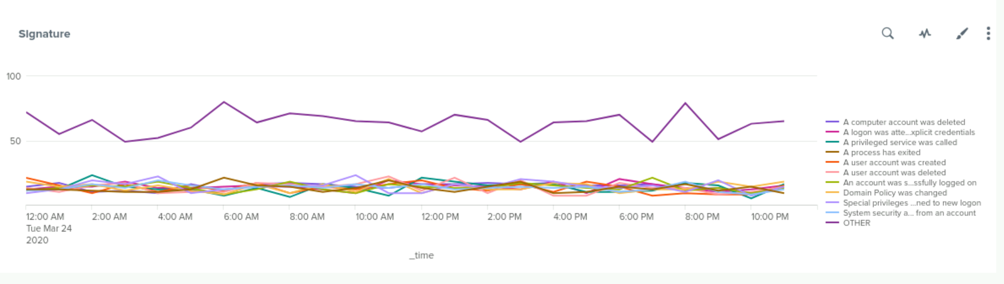
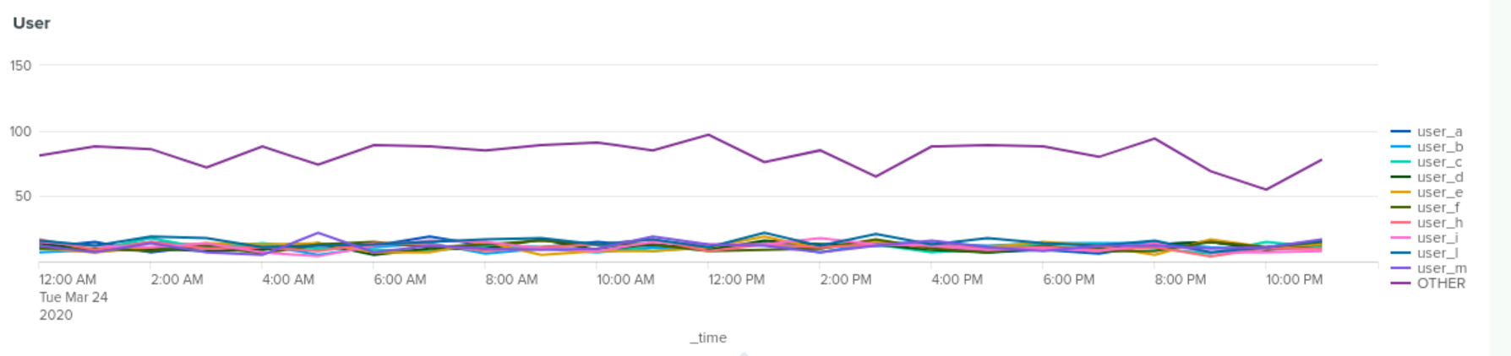
Dashboards—Windows
Place image here
Place image here

Slide 17
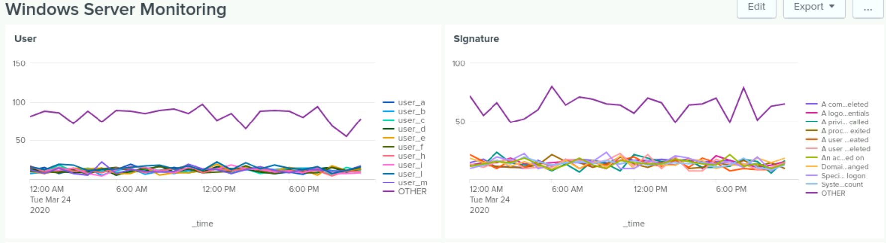
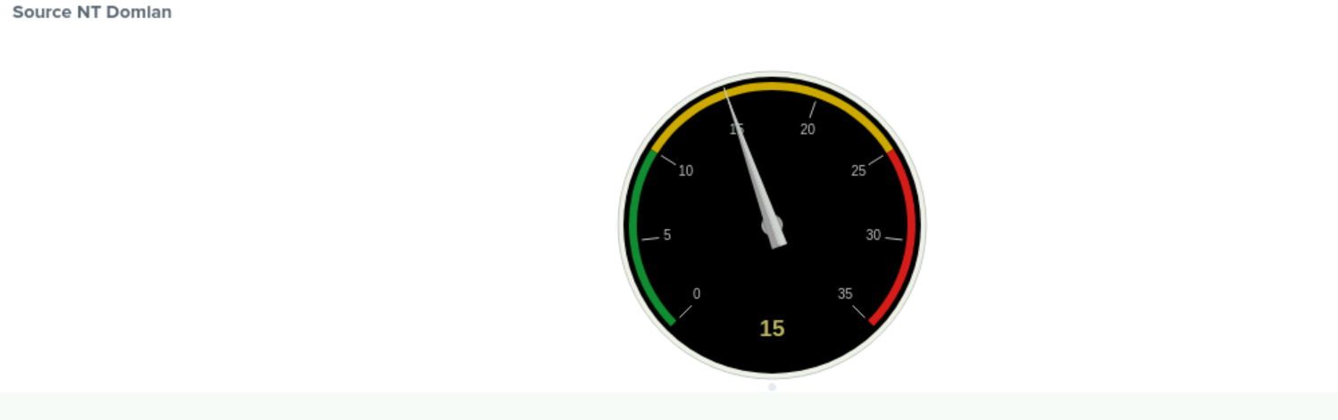
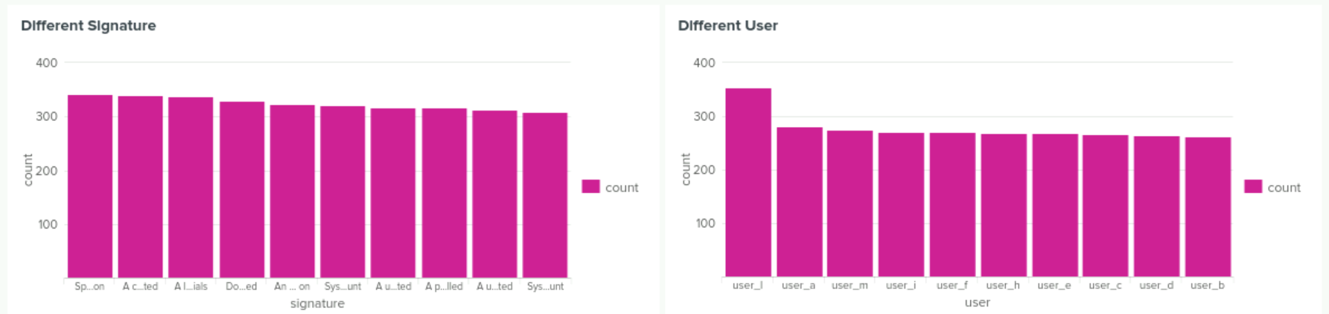
Dashboards—Windows

Slide 18
Apache Logs
‹#›

Slide 19
Reports—Apache
Report Name | Report Description
HTTP Methods | Shows GET, HEAD, OPTIONS,POST
Top 10 Domain | People from various countries are trying to GET access
HTTP Response | This show the status of the HTTP response code EX. 404, 200

Slide 20
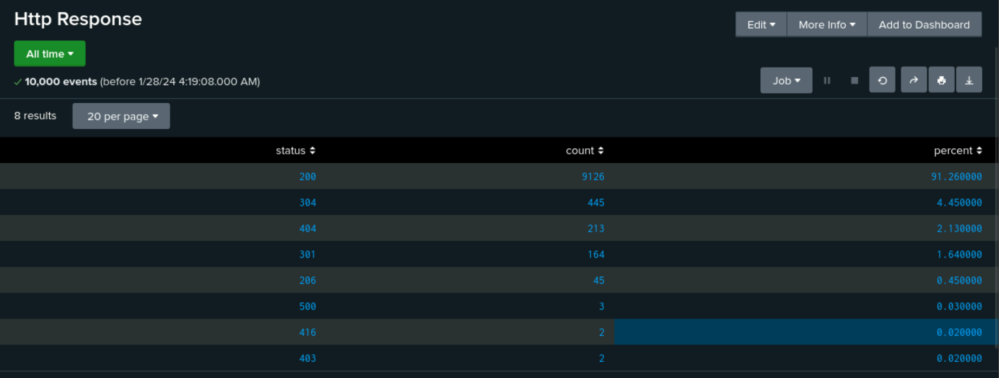
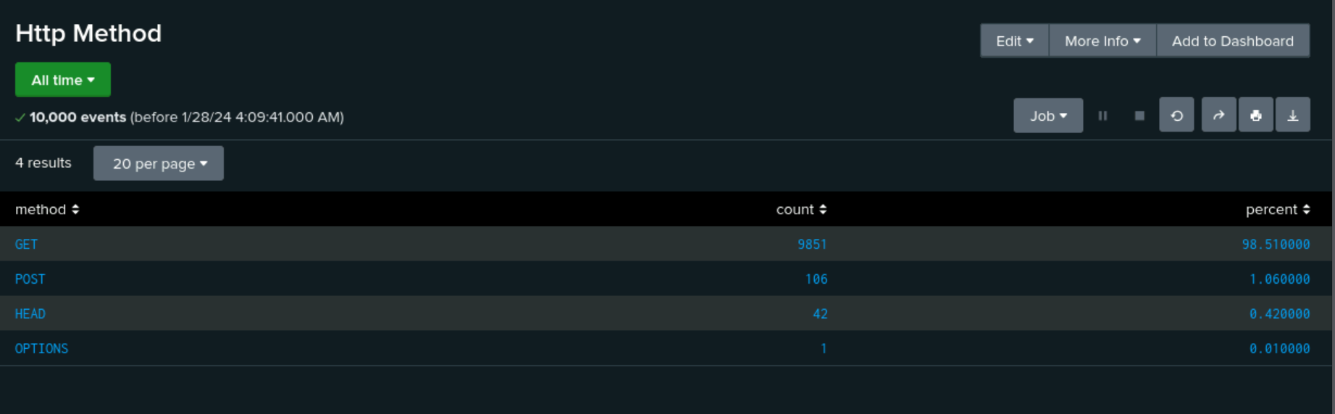
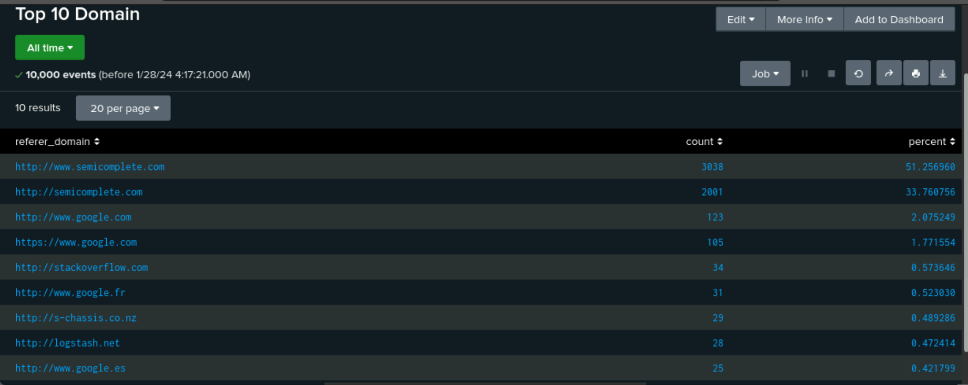
Images of Reports—Apache
Report Image
Report Image
Report Image

Slide 21
Alerts—Apache
Alert Name | Alert Description | Alert Baseline | Alert Threshold
Alert Ukraine | Alert anytime we see activity from Ukraine | 0 | 0
JUSTIFICATION: It’s important for the organization to know when foreign entities are trying to gain access to our internal logs. As a US based corporation, we need to ensure that our internal logs are kept secure.

Slide 22
Alerts—Apache
Alert Name | Alert Description | Alert Baseline | Alert Threshold
Alert Post | Daily Alert of Post | 1 | 7
Justification: Apache alert posts can be used to monitor the performance of your web server. This includes tracking metrics such as response times, request rates, server load, and resource utilization. Identifying performance bottlenecks helps you optimize your server for better responsiveness and user experience.

Slide 23
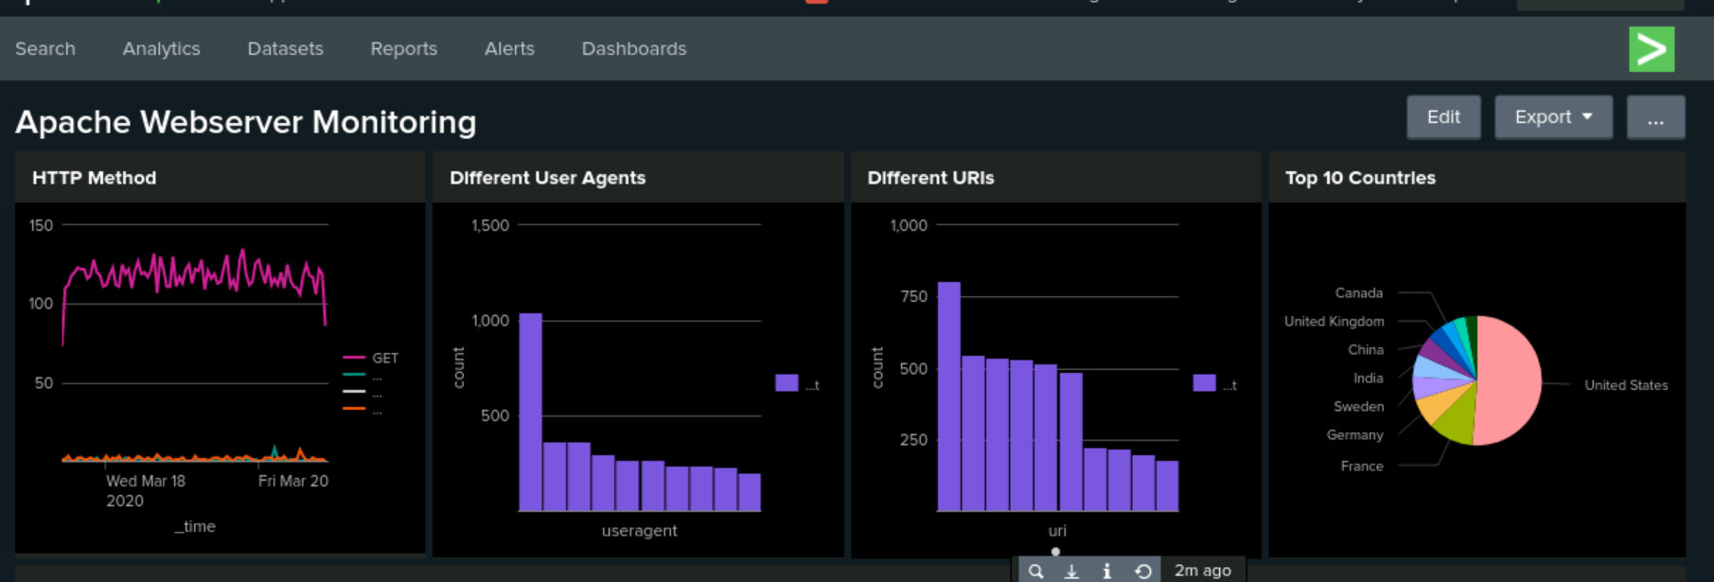
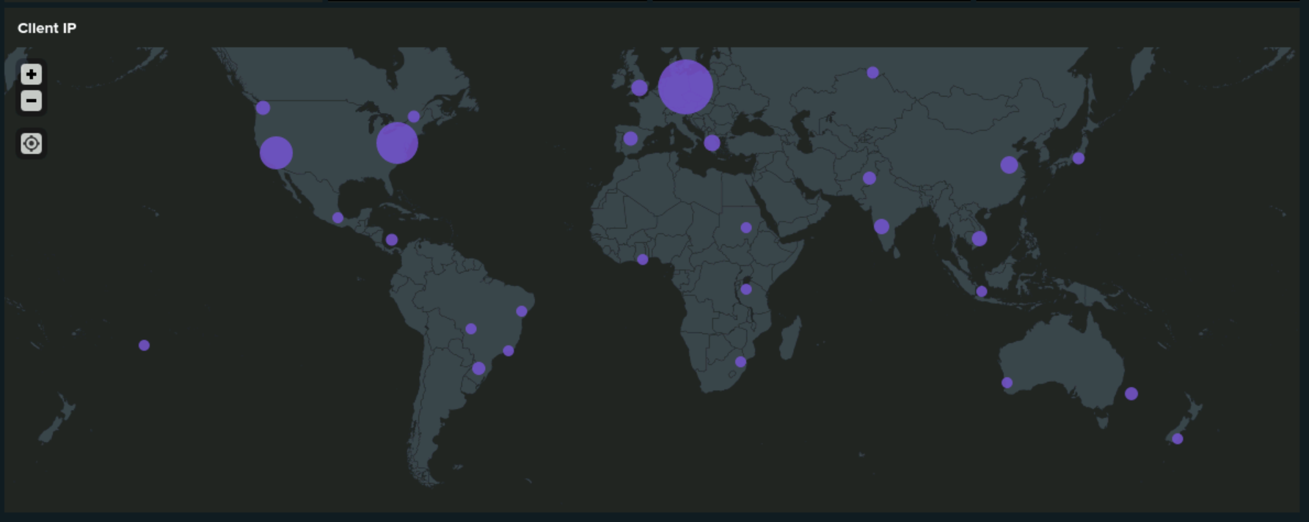
Dashboards—Apache
Place image here

Slide 24
Attack Analysis
‹#›

Slide 25
Attack Summary—Windows
While analyzing our reports for windows attack logs we noticed:
A large spike in successful logins
Password reset attempts
Even a few user lockouts.
With consideration we came to the conclusion that the attacker was performing a brute force attack. Although many were unsuccessful, there were quite a few accounts that were compromised. The attacker was able to gain user access and began attempting to reset the users passwords.

Slide 26
Attack Summary—Windows
Summarize your findings from your alerts when analyzing the attack logs. Were the thresholds correct? Yes, they were.
Our goals with the thresholds were the following:
- Understanding VSI’s Normal data but not creating false positives
- We set our threshold to ensure that we don’t impact day to day to business initiatives.
- Our thresholds were used to help guide us setting SLO’s (Service Level Objectives) with key performance indicators.
- VSI reviewed baseline and thresholds with our counter departments such as Operations and C-Level Executives to understand expectations.

Slide 27
Attack Summary—Windows
Summarize your findings from your dashboards when analyzing the attack logs.
Based on what we saw with the dashboard we took note of the signature increase with certain users. Those users being user_a, user_k, and user_j. These accounts seem to be responsible for user lockouts, password reset attempts, and successful logins.

Slide 28
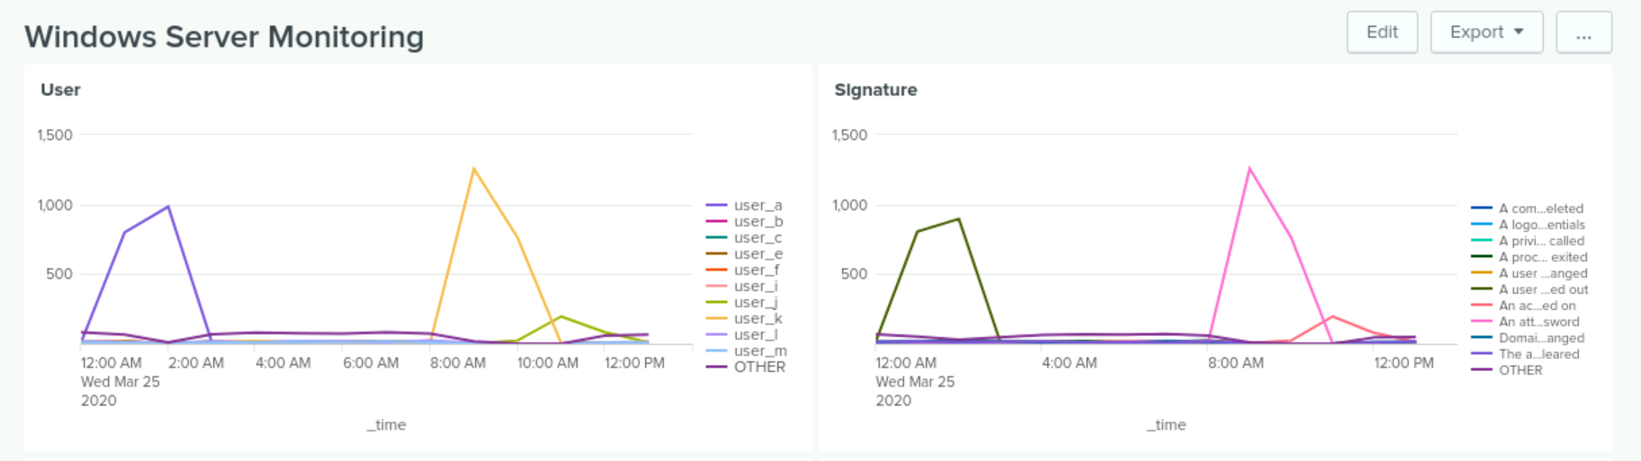
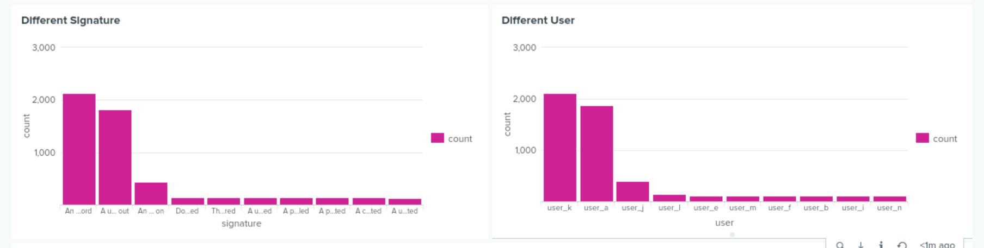
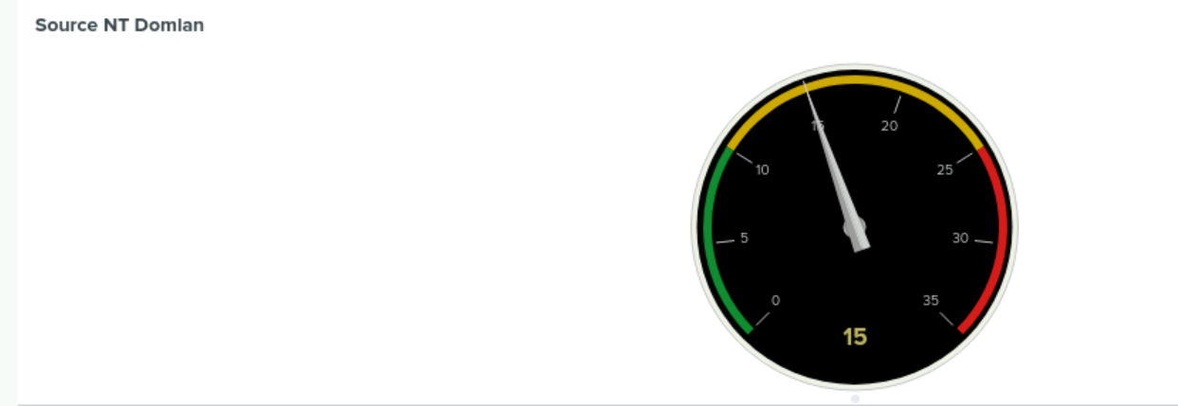
Screenshots of Attack Logs

Slide 29
Attack Summary—Apache
Summarize your findings from your reports when analyzing the attack logs.
We found suspicious actions in HTTP method. One being POST requests were very high and another being GET requests decreasing after the attack.
There were unfamiliar domains in the referrer attack logs such as New Zealand and Ukraine.
We noticed a large change in HTTP responses codes. It seems the main two were 200 and 404. There were more 404 response codes than 200 response codes. This shows that the attacker was trying to make requests that were not available on the host.

Slide 30
Attack Summary—Apache
Summarize your findings from your alerts when analyzing the attack logs. Were the thresholds correct?
Suspicious actions were found in http method such as “post” requests which were high.
Suspicious activity found in top domains where we found suspicious domains in the attack logs and a change of number of traffic.
A significant change in response codes with 200 response codes showing less and 404 codes increased.

Slide 31
Attack Summary—Apache
Summarize your findings from your dashboards when analyzing the attack logs.
Based on what this dashboard is indicating the HTTP Method, the line graph displayed a higher attempt for clients interacting with the web during 4PM.
Different User agent displays high count that may have been an attempt by users or bots.
According to the Geolocation Bubble Map POST, HTTP Methods indicates that Ukraine had an unusual high count for IP network traffic.

Slide 32
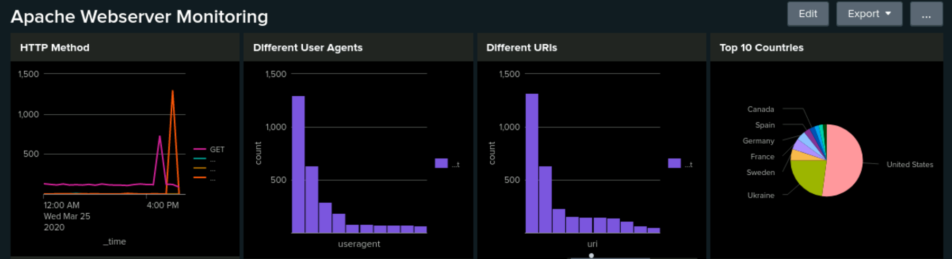
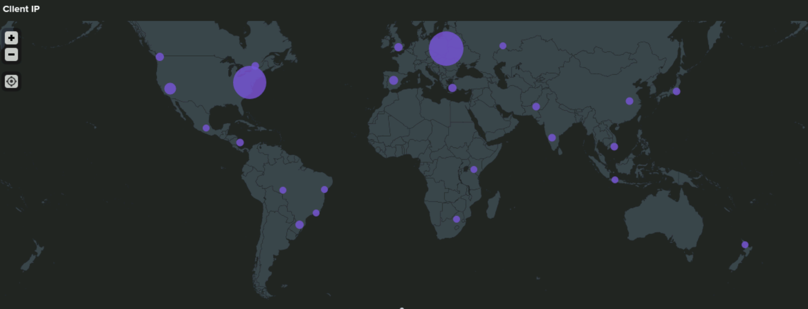
Screenshots of Attack Logs
[Optional: Place images that illustrate attack findings here.]

Slide 33
Summary and Future Mitigations
‹#›

Slide 34
Project 3 Summary
What were your overall findings from the attack that took place?
The attackers used brute force attack to gain access to accounts and attempted to reset passwords.
With the increase in 404 codes we deemed that some web applications were taken down.
To protect VSI from future attacks, what future mitigations would you recommend?
We would recommend regular security audits and penetration testing. This would consist of identify address or domain vulnerabilities.
Another mitigation would be Intrusion Detection and Prevention System (IDPS) this will help us monitor traffic and impede malicious users from entering the systems network.
Multi-Factor Authentication

